Slide 1


DomoticsHub-The Heart of Home Automation
Presentation by DomoticDynamos
February - 2025

Slide 2
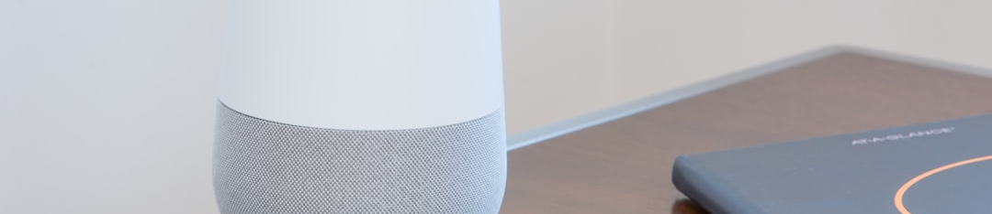

Objectives and Goals
ENHANCING HOME AUTOMATION
The goal is to create a centralized home automation platform. This enhancement aims to boost comfort, security, and energy efficiency for users.

Slide 3

Identifying Problems
APP OVERLOAD
INTEGRATION GAPS
LIMITED FUNCTIONALITY
Users manage multiple disconnected smart devices, leading to frustration and inefficiency.
Different subsystems lack integration, making seamless operation challenging.
Existing solutions are often insufficient in features, limiting user experience and convenience.

Slide 4


Our Solution
CENTRALIZED CONTROL POINT
DomoticsHub serves as a central control point for managing all smart devices, improving user engagement.
USER-FRIENDLY INTERFACE
The platform offers a user-friendly interface, accessible via smartphones or computers, ensuring easy navigation and control.

Slide 5

Core Features
COMPREHENSIVE CONTROL
REMOTE ACCESS
ENERGY MONITORING
Centralized management of lighting, heating, security, and appliances ensures effortless operation.
Allows control from anywhere, enhancing accessibility and convenience for users.
Tracks energy consumption, optimizing usage and promoting sustainability.

Slide 6

Additional Considerations
SCALABILITY
PRIVACY PROTECTION
USER CUSTOMIZATION
DomoticsHub is designed for easy incorporation of new devices and features.
Robust data protection measures ensure user privacy and security are prioritized.
Personalized automation schedules empower users to tailor their home automation experience.

Slide 7


Conclusion
TRANSFORMING HOME AUTOMATION
DomoticsHub significantly enhances home automation through seamless integration, user-friendly interfaces, and robust features.

